Slide 1




Congrats Grads!
Child and Family Tennessee’s Transitional Housing Program has been helping women gain self-sufficiency and freedom from violence since 2007.

Slide 2


Giving women and their children a new start; giving them hope.

Slide 3

Kind words from our clients
“My advocate was the best. She made sure she was there for me at every step.”
“Things couldn’t have happened for us without my advocate.”
“I feel very blessed to have the assistance of the staff. They have been great to my daughters and me.”
“In every possible way the staff has been very helpful and always kind, always available and assisting me when needed.”

Slide 4


“Transitional housing is a stepping stone to permanent housing for these ladies. Without the benefits of the transitional housing programs, some of these ladies may not be able to obtain permanent housing or to maintain housing with private market properties.”
–Debbie Taylor-Allen, KCDC Section 8 Housing Director

Slide 5
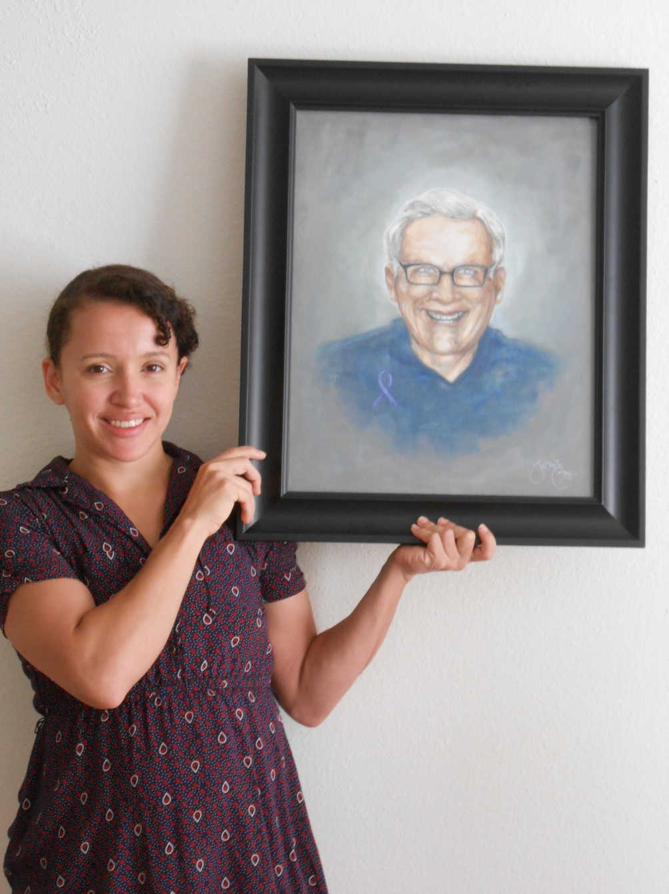

Inspiring
success

Slide 6
“Transitional Housing Program has been a safety net to many victims transitioning out of the Family Crisis Center since so many face barriers to being self-sufficient. Beyond housing and stability, I think the best part of the Transitional Housing Program is the long-term support and advocacy that so many of our clients need. Without continued support, many may have ended up homeless or back with abusive partners. The THP is a vital part of the continuum of services for domestic violence victims in Knoxville.”
–Amy Canfield, Child & Family Tennessee
Family Crisis Center Supervisor

Slide 7
Kind words from our clients
“I’m really grateful for everything. My advocate has been a blessing. Thanks to all those involved for getting me where I am today.”
“My advocate goes out of her way to help me with whatever I may need. She is kind and understanding.”
“I’ll be thankful for this program for the rest of my life. It allowed me to get away from my abuser and learn skills to cope with the violence.”

Slide 8



Slide 9

Transitional Housing has
served 143 adults since its inception.
Transitional Housing
has served 202 children.

Slide 10
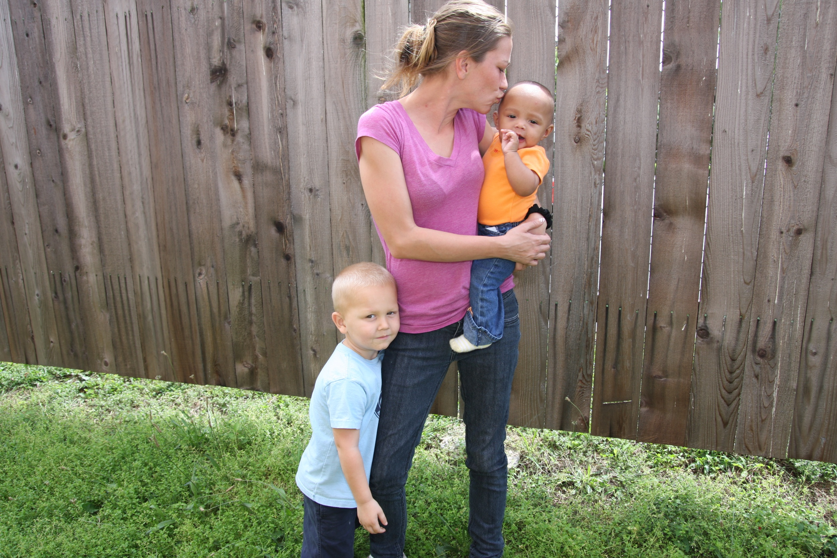
Building a
home together

Slide 11
Fifty-seven Transitional Housing
clients have received education advocacy.
More than 100 Transitional Housing
clients have received employment advocacy.

Slide 12
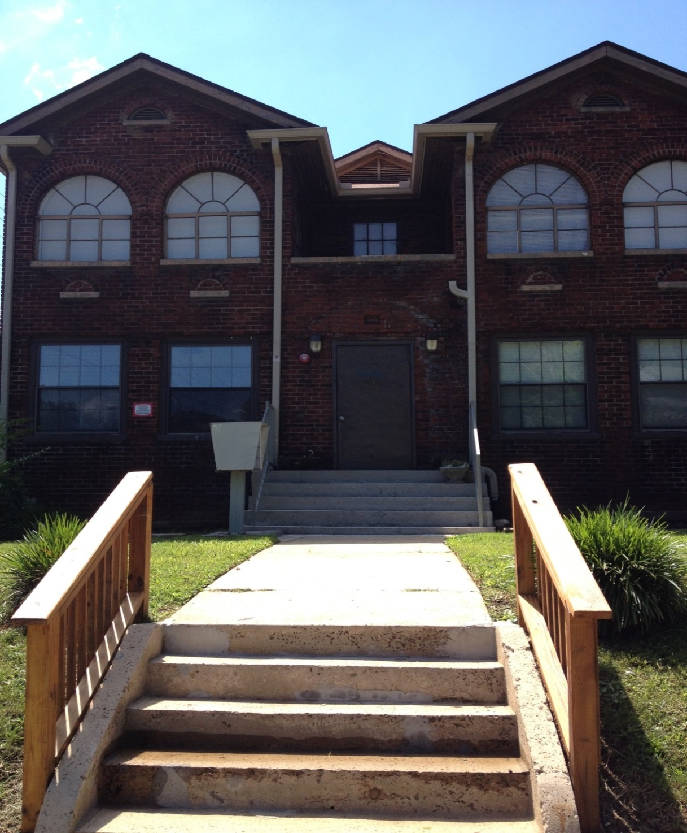
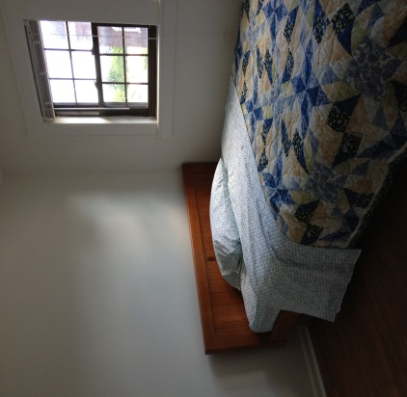
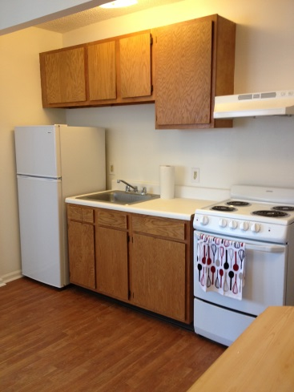
In 2012 THP expanded
by acquiring a property that will house six families.

Slide 13
Partner Quote

Slide 14
84% of Transitional Housing clients
say the program has helped them
learn how to access community resources.
83% of Transitional Housing clients say the program has given them a better understanding of the cycle of domestic violence and its effects on their life.

Slide 15
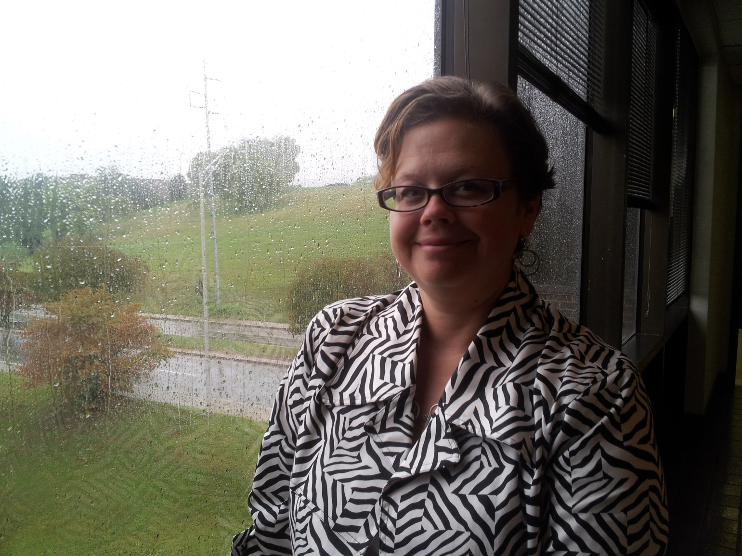
On
her Way

Slide 16
Partner Quote

Slide 17
A brighter tomorrow for your children

Slide 18
Partner Quote

Slide 19








Thanks to our community partners and supporters!

Slide 20
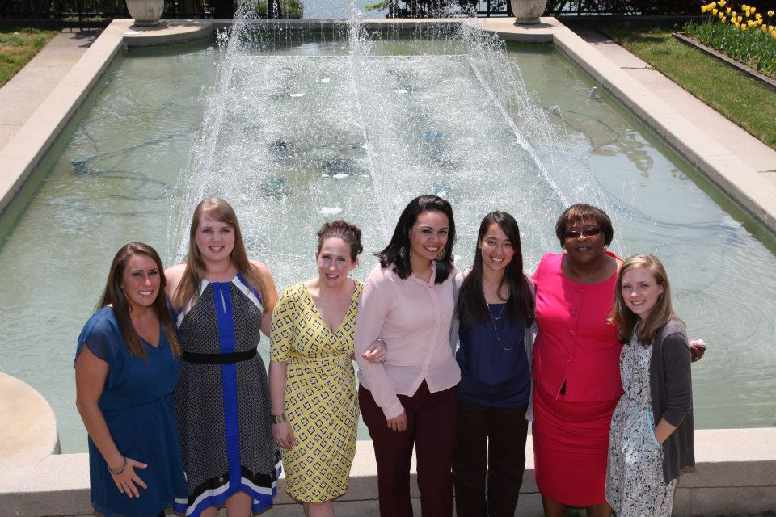

Wishing the best to each of you and your families!
-Child & Family’s Transitional
Housing and Family Crisis Center staff

